Slide 1

BY: REVATI PADGILWAR

Slide 2
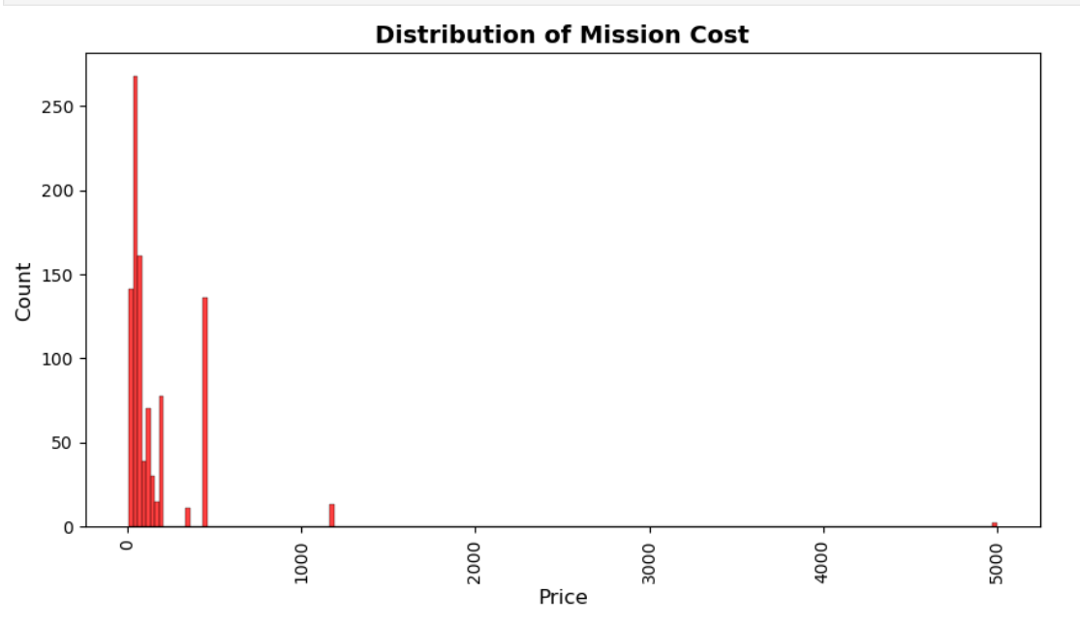
DISTRIBUTION OF MISSION COST
Key Insights from Mission Cost Distribution Chart
High Concentration of Low-Cost Missions
Most missions fall within the 0–200 cost range, showing that the majority of operations are low-cost and likely standardized, routine activities. This suggests a strong emphasis on efficiency and repeatable mission structures.
Significant Drop in Mid-Range Mission Frequency
Missions in the 200–800 cost range occur far less frequently. This indicates that mid-level missions—those requiring moderate resources or complexity—are relatively uncommon within the overall mission portfolio.
Presence of Rare but Extremely High-Cost Missions
A few missions have costs around 1000, 1600, and even 5000, standing out as extreme outliers. These represent highly specialized, resource-intensive operations that occur infrequently but likely carry strategic or critical importance.
Strong Skewness in Cost Distribution
The overall distribution is heavily right-skewed due to the extremely high-cost missions. This skew suggests that while most missions are inexpensive, a very small number disproportionately impact average cost calculations and budget planning.
Strategic Resource Allocation Insights
The dominance of low-cost missions indicates stable and efficient operational planning, while the rare high-cost outliers highlight areas where budgeting must account for occasional large expenditures. Organizations might explore cost optimization for these exceptional missions or plan dedicated funding pools.

Slide 3
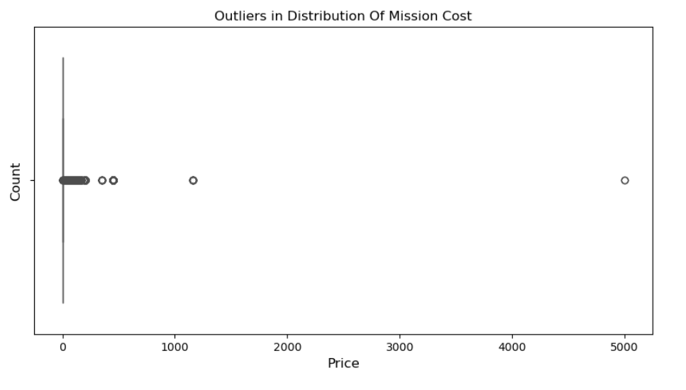
OUTLIERS IN DISTRIBUTION OF MISSION COST
Key Insights from Mission Cost Outliers Chart
Concentration of Typical Mission Costs
The boxplot shows that almost all missions fall within a very tight low-cost range. This indicates that the majority of operations are standardized, predictable, and relatively inexpensive to execute.
Visible High-Cost Outliers
Several data points appear far to the right at significantly higher cost levels, marking them as clear outliers. These missions stand out because their costs are dramatically higher than the operational norm.
Large Variance Between Regular Missions and Outliers
The wide horizontal spread between the main cluster and the few distant points highlights a large cost variance. This suggests that while routine missions are consistent, the cost of exceptional missions can escalate sharply.
Indicator of Rare but Resource-Intensive Missions
The extreme outliers likely represent missions that require unique resources, specialized equipment, or extended timelines. Their location on the plot suggests these are rare events but have substantial financial impact.
Implications for Budget Planning
The mix of mostly low-cost missions with a few extremely high-cost ones means budgeting must account for both daily operational stability and occasional high-expense missions. Identifying why these outliers occur can support better forecasting and cost control.

Slide 4
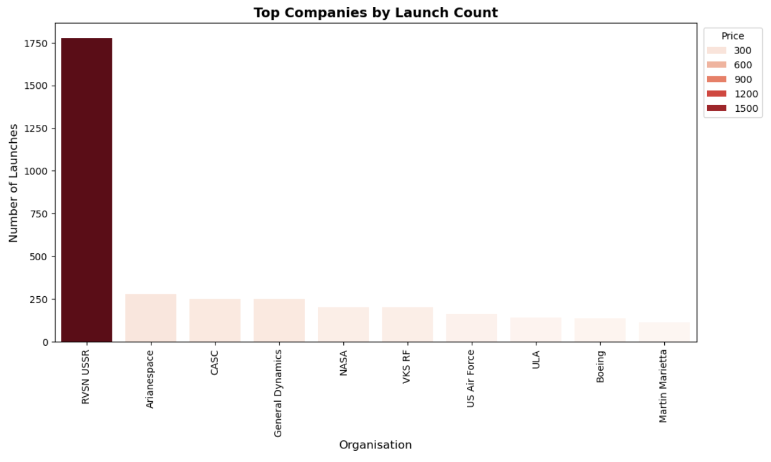
TOP COMPANIES BY LAUNCH COUNT
Key Insights from the Bar Plot of Top Companies by Launch Count
RVSN USSR Dominates the Launch Landscape
RVSN USSR shows an extremely tall bar with over 1,700 launches, clearly standing out from all other organizations. This indicates a long history of frequent launch activity and a major role in global space operations.
Large Gap Between the Leader and All Other Companies
The bar representing RVSN USSR is many times taller than the rest, showing a huge disparity in launch volume. No other organization comes close, highlighting how concentrated launch activity has been historically.
Arianespace, CASC, and General Dynamics Form a Secondary Group
These companies have bars around the 250–300 launch range, placing them well below the leader but still showing strong participation in the space sector. Their consistent launch activity likely reflects commercial and international missions.
Moderate Activity from NASA and VKS RF
Both NASA and VKS RF have bars slightly above 200 launches, putting them in a mid-range category. This level suggests they focus more on mission complexity and scientific goals rather than frequent launches.
Lower but Steady Contributions from ULA, US Air Force, Boeing, and Martin Marietta
These organizations show shorter bars, between 120–180 launches. Their smaller launch counts may reflect specialized missions, military priorities, or commercial launches tied to specific contracts.

Slide 5
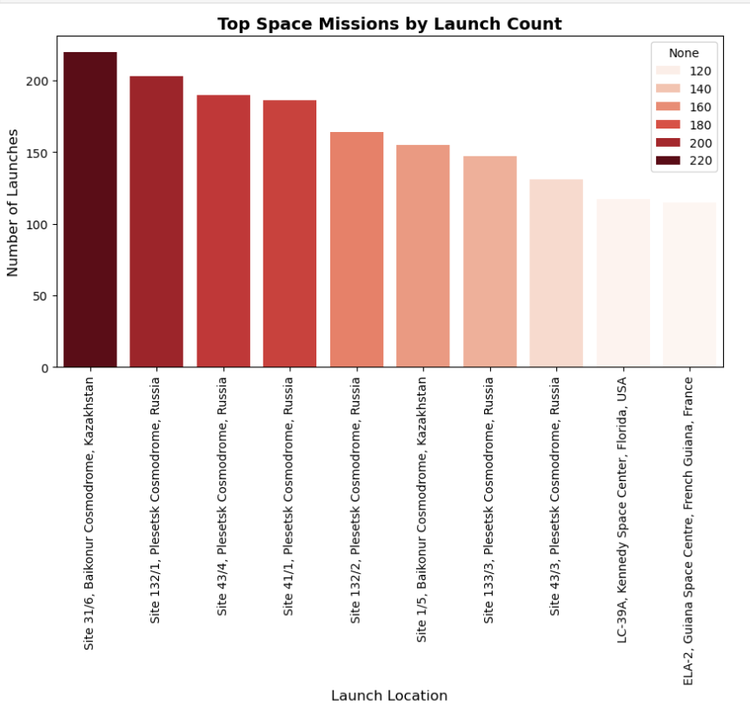
TOP SPACE MISSIONS BY LAUNCH COUNT
Key Insights from Top Space Missions by Launch Count
Baikonur Leads in Launch Activity
Baikonur’s Site 31/6 shows the highest launch count, proving its strong global importance and long operational history.
Russian Launch Sites Dominate
Most top positions are occupied by Plesetsk and Baikonur pads, showing Russia’s high-frequency and continuous space mission activity.
Strategic Presence of U.S. and Europe
Only Kennedy Space Center (USA) and Guiana Space Centre (Europe) appear, indicating fewer but high-value missions compared to Russia.
Clear Launch Density Pattern
The color gradient reveals that Russian sites handle the highest launch volumes, while international sites show moderate activity.
Strong Legacy of Soviet-Era Infrastructure
Many top sites are decades old, showing that historic Soviet launch pads remain crucial for current space operations.

Slide 6
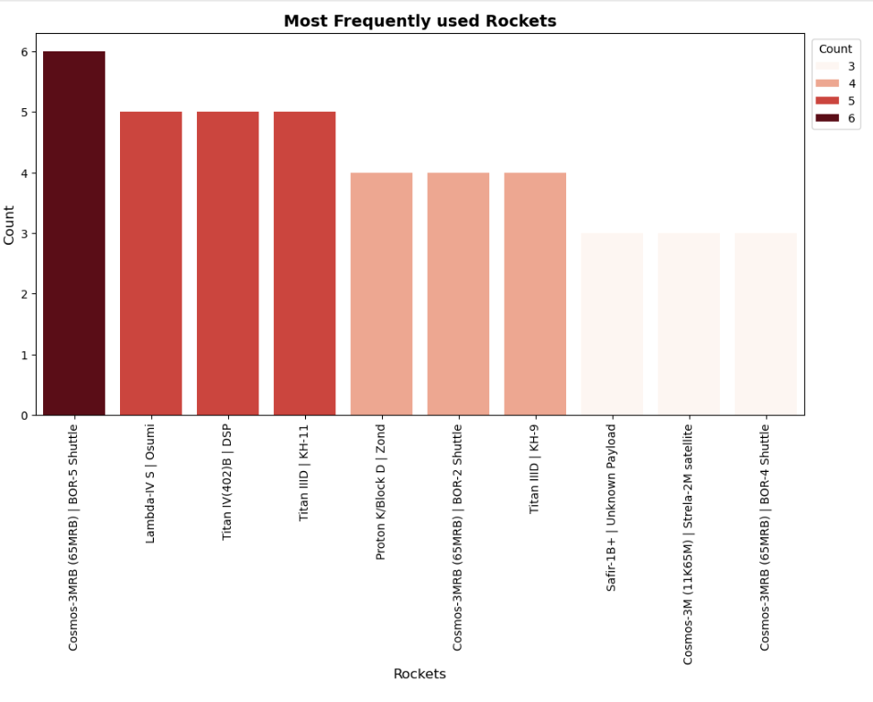
MOST FREQUENTLY USED ROCKETS
Key Insights from Most Frequently Used Rockets
Most Used Rocket: Cosmos-3MRB (BOR-5)
Cosmos-3MRB with the BOR-5 Shuttle appears 6 times, showing it was the most reliable and frequently chosen rocket.
High-Frequency Rockets (5 Launches)
Lambda-4S, Osumi, Titan IV(402)B, and Titan IIID | KH-11 all show 5 launches, indicating they were consistently used for important satellite and defense missions.
Medium-Use Rockets (4 Launches)
Proton K | Block D | Zond, Titan IIID | KH-9, and Cosmos-3MRB (BOR-2) each appear 4 times, suggesting they supported specific programs like lunar tests or reconnaissance missions.
Low-Use Rockets (3 Launches)
Safir-1B, Cosmos-3M, Strela-2M, and Cosmos-3MRB (BOR-4) have 3 launches, showing they were used for small-scale, experimental, or limited operations.
Usage Highlighted by Color Gradient
Darker bars represent rockets with higher launch counts, while lighter bars show lower usage, making the frequency differences easy to see.

Slide 7
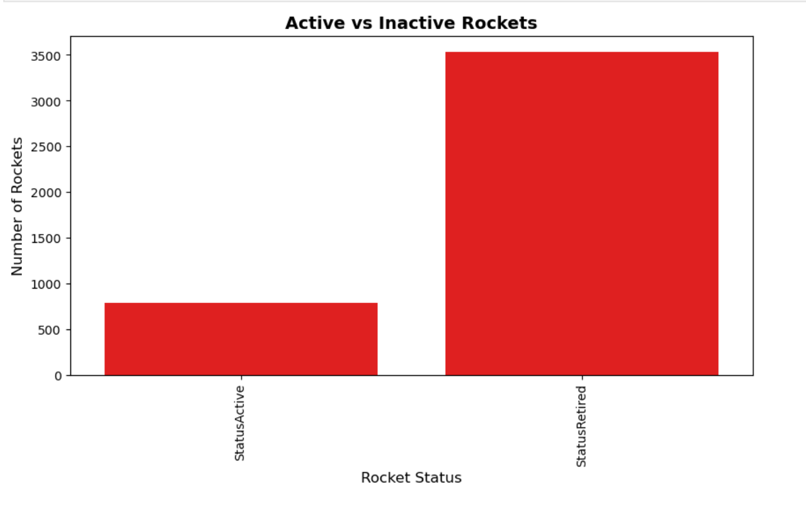
ACTIVE VS INACTIVE ROCKETS
Key Insights from Active VS Inactive Rockets Chart
Dominance of Retired Rockets
A total of 3534 rockets are retired, showing that most launch vehicles developed over the years have completed their operational life and are no longer used in modern space missions.
Limited Number of Active Rockets
Only 790 rockets remain active, indicating that space agencies currently rely on a much smaller and more efficient set of rockets for ongoing launches.
Continuous Technological Evolution
The large gap between retired and active rockets highlights how rapidly technology in the space industry evolves, leading older models to be phased out as new, advanced, and safer rockets emerge.
Active Rockets Represent Modern Standards
The relatively small count of active rockets reflects the highly optimized, reusable, and performance-focused systems used today for commercial, scientific, and defense missions.
Retired Rockets Showcase Historical Growth
The vast number of retired rockets represents decades of global space advancements, capturing earlier designs, experimental models, and legacy systems that contributed to the development of today’s modern launch vehicles.

Slide 8
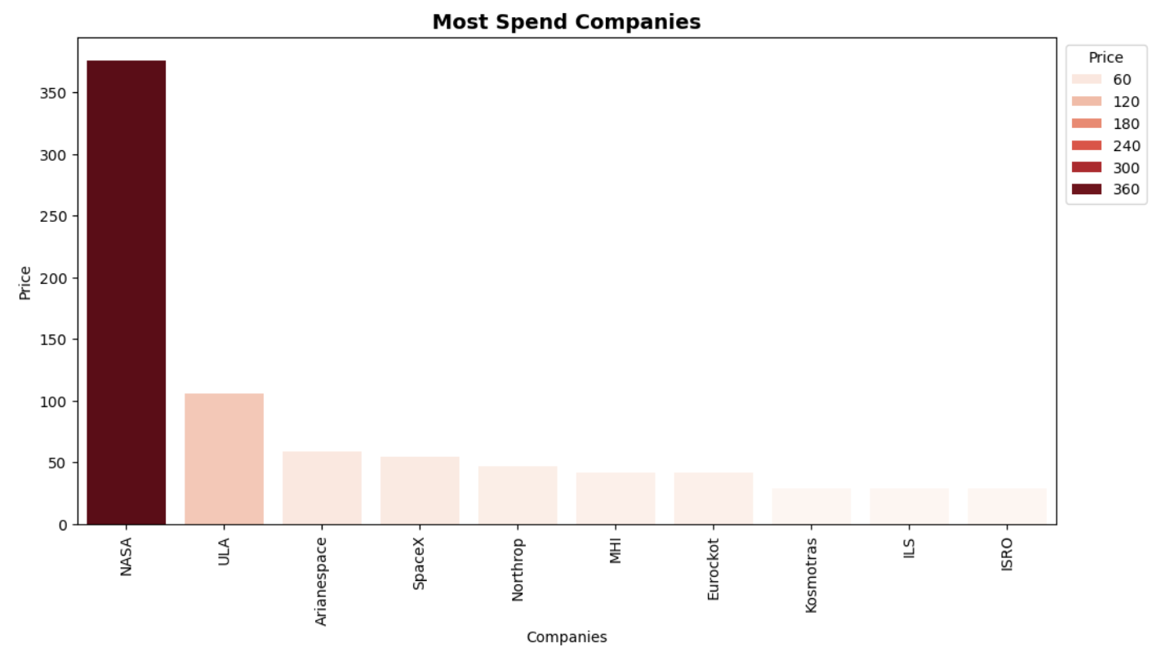
MOST SPEND COMPANIES
Key Insights from Most Spend Companies
NASA Leads with the Highest Spending
NASA spends 375.76, far exceeding all other companies, showing its massive investment in space missions, research, and technology development compared to global competitors.
ULA Holds the Second-Highest Spending
United Launch Alliance spends 105.7, indicating strong funding for reliable launch services, but still nowhere near NASA’s scale of expenditure.
European and Private Companies Have Moderate Spending
Arianespace (58.58) and SpaceX (54.44) show mid-range spending levels, reflecting steady but controlled investments focused on cost-effective and commercial launch solutions.
Northrop and MHI Maintain Balanced Budgets
Northrop (47.35) and MHI (42.05) maintain moderate spending, suggesting a balanced approach between innovation, manufacturing, and mission operations.
Lower Spending by Niche or Specialized Agencies
Eurockot, Kosmotras, ILS, and ISRO (ranging 28–41) spend significantly less, indicating either smaller mission frequency, cost-efficient launch systems, or more limited financial capacity.
Huge Spending Gap Between NASA and Others
The spending gap between NASA and the next highest spender (ULA) is more than 3×, showing NASA’s dominant role in global space funding.

Slide 9
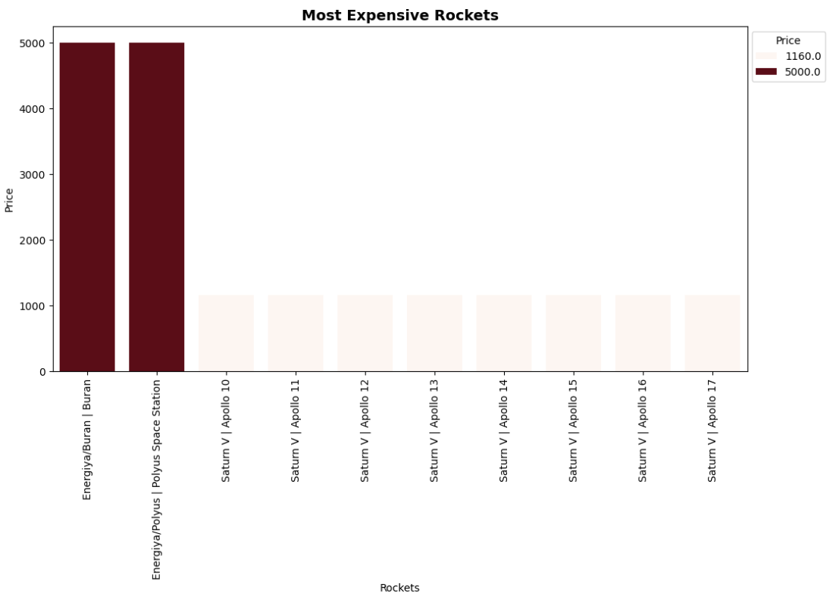
MOST EXPENSIVE ROCKETS
Key Insights from Most Expensive Rockets Chart
Energiya Missions Are the Costliest
Energiya/Buran and Energiya/Polyus are the most expensive rockets, each costing about 5000 units, clearly higher than all others.
Huge Cost Gap with Saturn V
Each Energiya launch costs over four times as much as a Saturn V Apollo mission (1160 units), showing how expensive the Soviet shuttle and space-station test flights were.
Uniform Cost Across Apollo Missions
All Saturn V missions from Apollo 10 to Apollo 17 have the same cost (1160 units), indicating standardized hardware and operations.
Economies of Scale in Saturn V Program
Reusing the same rocket design and infrastructure for multiple Apollo missions likely reduced cost variations and improved per-launch efficiency.
Energiya as High-Investment, Low-Flight Program
The very high cost of Energiya suggests heavy R&D and advanced technology spread over very few flights, making each mission extremely expensive.
Strategic Trade-off for Space Agencies
The chart highlights a trade-off: cutting-edge but rare systems like Energiya are very costly per launch, while repeated, standardized systems like Saturn V offer better cost efficiency per mission.

Slide 10
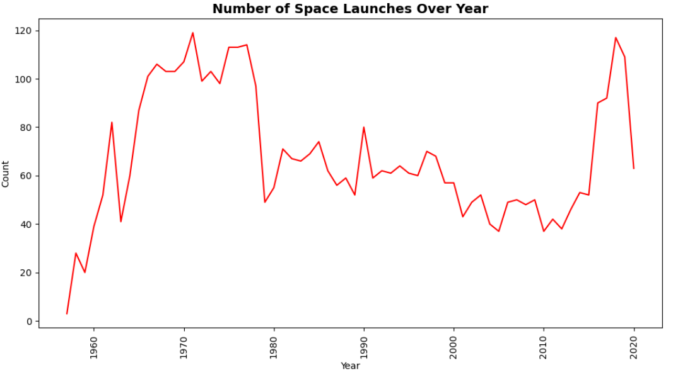
NUMBER OF SPACE LAUNCHES OVER YEAR
Key Insights from Number of Space Launches Over Year Line Chart
Rapid Growth in the 1960s
From the late 1950s to the mid-1960s, the number of launches rises sharply, reflecting the early Space Race and intense competition between superpowers to reach orbit and the Moon.
Peak Activity Around Late 1960s–Early 1970s
Launches reach very high counts close to 120 per year around 1967–1972, showing the peak investment period with multiple lunar, planetary, and military missions.
Decline After the Early 1970s
After this peak, the number of launches drops noticeably in the mid- to late-1970s and early 1980s, likely due to budget cuts, program completions (e.g., Apollo), and shifts in priorities.
Moderate and Fluctuating Activity (1980s–2000s)
Between the 1980s and early 2000s, launches remain moderate (roughly 50–80 per year) with fluctuations, indicating a more stable but less aggressive pace of space activity.
Temporary Dip Around Early 2000s
There is a visible dip in the early 2000s, suggesting a slowdown possibly linked to economic factors, accidents, or restructuring of major space programs.
Strong Resurgence After 2010
From around 2010 onward, launches climb again, reaching levels above 100 per year by the late 2010s, reflecting renewed global interest, commercialization of space, and the rise of private launch providers.

Slide 11
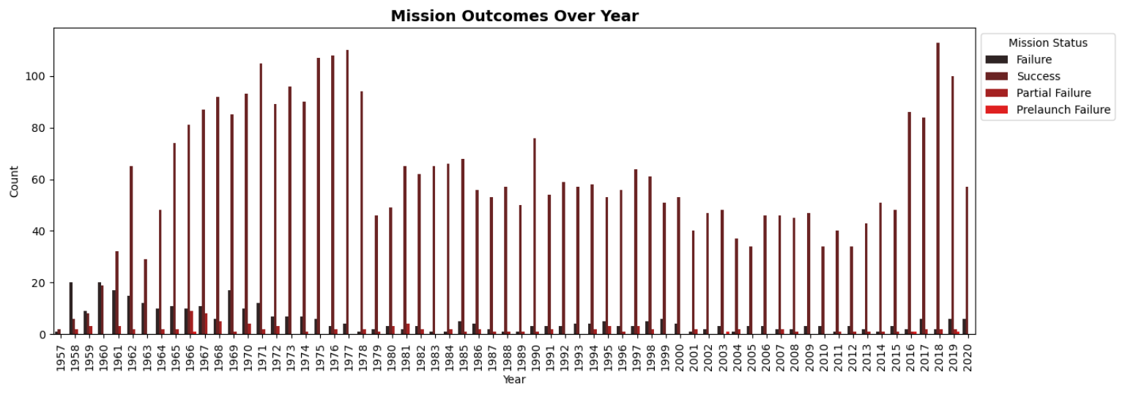
MISSION OUTCOMES OVER YEAR

Slide 12
Key Insights from Mission Outcomes Over Year Chart
Strong Growth in Successful Missions
Successful missions increase sharply from the late 1950s, peaking around the late 1960s–1970s and again after 2015, showing major improvements and renewed activity in space programs.
Failure Counts Decrease Over Time
Mission failures are relatively high in the early years but gradually drop to low single digits later, indicating better technology, testing, and operational experience.
Partial Failures Remain Limited
Partial failures stay low across most years, suggesting that when problems occur, missions are typically classified clearly as success or failure rather than mixed outcomes.
Prelaunch Failures Are Rare
Prelaunch failures (issues before liftoff) appear only in very small numbers, showing that ground checks and safety procedures are largely effective.
High Success Rate in Recent Years
In the 2010s, successful missions rise sharply while failures remain low, reflecting modern reliability and the impact of advanced systems and private space companies.
Overall Trend Toward Reliability
Comparing the early space race era to recent years, the chart shows a clear long-term shift from frequent failures to predominantly successful missions, highlighting continuous improvement in space technology and management.

